Slide 1

Module 5 Unit 2
Nine girls?

Slide 2




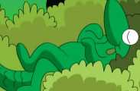
How many colours?
five

Slide 3
How many?
eight

Slide 4
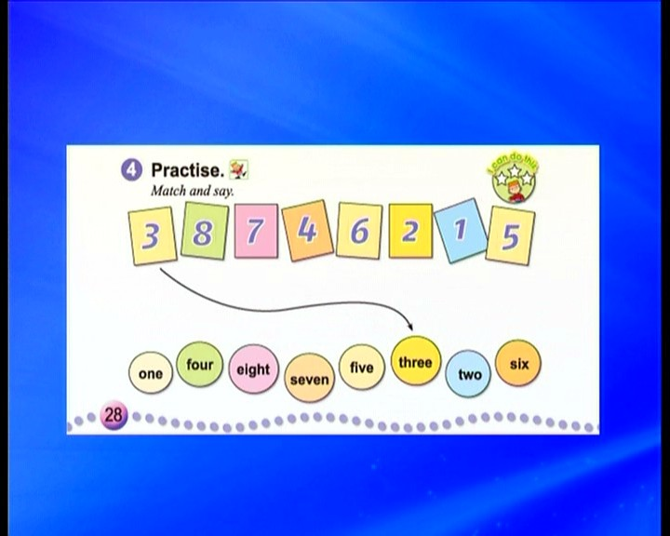
Look and read:

Slide 5
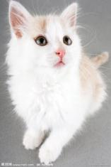

How many ?
nine
ten

Slide 6
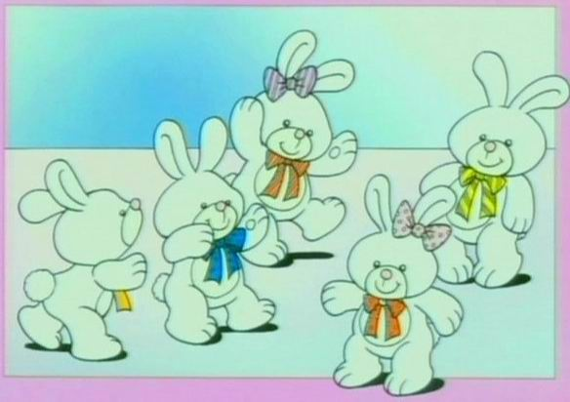
EX: How many rabbits?
five ten

Slide 7
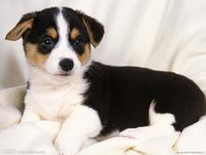
EX: How many dogs?
eight nine

Slide 8

How many chairs?
PPT模板：www.1ppt.com/moban/ PPT素材：www.1ppt.com/sucai/
PPT背景：www.1ppt.com/beijing/ PPT图表：www.1ppt.com/tubiao/
PPT下载：www.1ppt.com/xiazai/ PPT教程： www.1ppt.com/powerpoint/
资料下载：www.1ppt.com/ziliao/ 范文下载：www.1ppt.com/fanwen/
试卷下载：www.1ppt.com/shiti/ 教案下载：www.1ppt.com/jiaoan/
PPT论坛：www.1ppt.cn PPT课件：www.1ppt.com/kejian/
语文课件：www.1ppt.com/kejian/yuwen/ 数学课件：www.1ppt.com/kejian/shuxue/
英语课件：www.1ppt.com/kejian/yingyu/ 美术课件：www.1ppt.com/kejian/meishu/
科学课件：www.1ppt.com/kejian/kexue/ 物理课件：www.1ppt.com/kejian/wuli/
化学课件：www.1ppt.com/kejian/huaxue/ 生物课件：www.1ppt.com/kejian/shengwu/
地理课件：www.1ppt.com/kejian/dili/ 历史课件：www.1ppt.com/kejian/lishi/
eleven seven
Notes:
PPT模板：www.1ppt.com/moban/ PPT素材：www.1ppt.com/sucai/
PPT背景：www.1ppt.com/beijing/ PPT图表：www.1ppt.com/tubiao/
PPT下载：www.1ppt.com/xiazai/ PPT教程： www.1ppt.com/powerpoint/
资料下载：www.1ppt.com/ziliao/ 范文下载：www.1ppt.com/fanwen/
试卷下载：www.1ppt.com/shiti/ 教案下载：www.1ppt.com/jiaoan/
PPT论坛：www.1ppt.cn PPT课件：www.1ppt.com/kejian/
语文课件：www.1ppt.com/kejian/yuwen/ 数学课件：www.1ppt.com/kejian/shuxue/
英语课件：www.1ppt.com/kejian/yingyu/ 美术课件：www.1ppt.com/kejian/meishu/
科学课件：www.1ppt.com/kejian/kexue/ 物理课件：www.1ppt.com/kejian/wuli/
化学课件：www.1ppt.com/kejian/huaxue/ 生物课件：www.1ppt.com/kejian/shengwu/
地理课件：www.1ppt.com/kejian/dili/ 历史课件：www.1ppt.com/kejian/lishi/

Slide 9
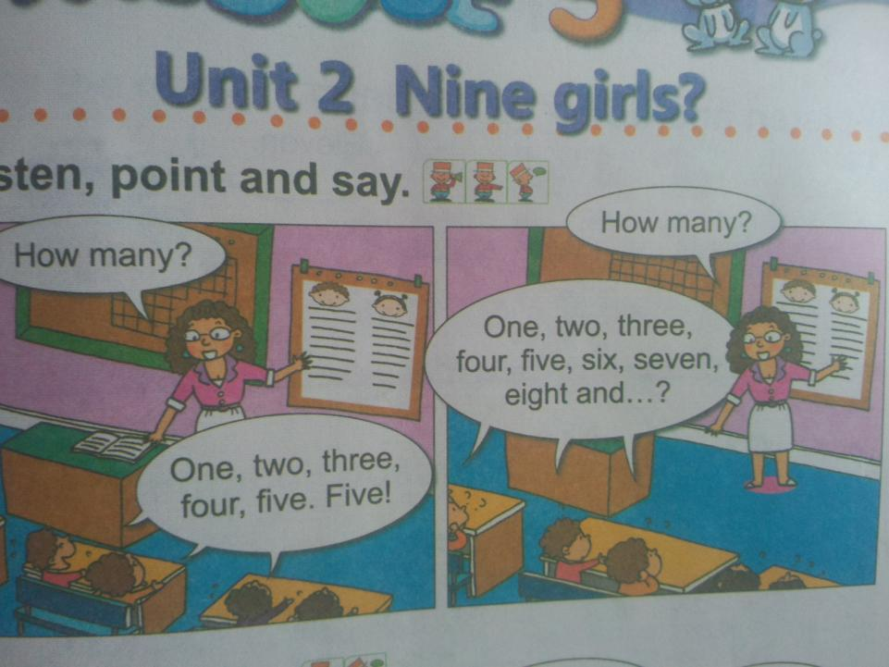
watch the video:

Slide 10
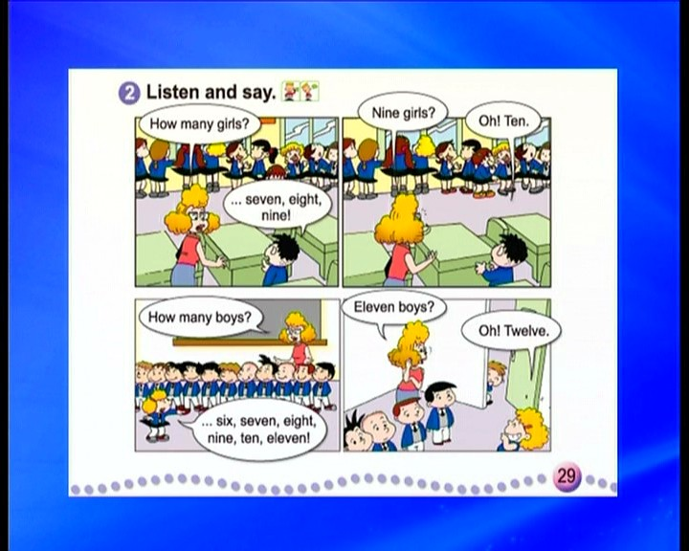


Listen,point and say.

Slide 11

Let's count!
How many girls in your group?
How many boys in your group?

Slide 12
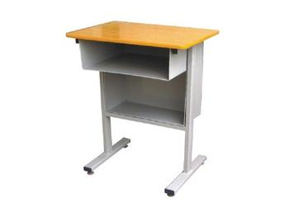

Guess: How many desks?
six

Slide 13
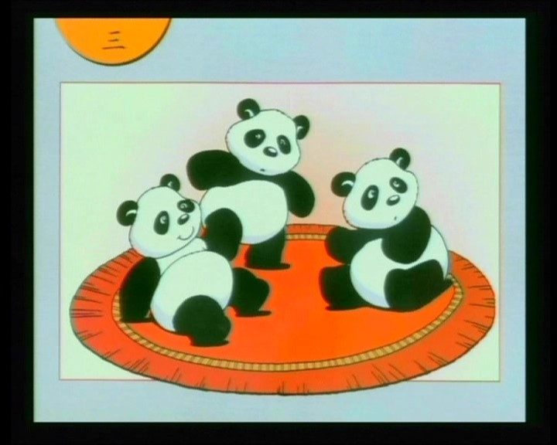
How many pandas?
three

Slide 14


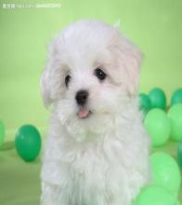

How many dogs?
ten

Slide 15

How many caps?
twelve

Slide 16
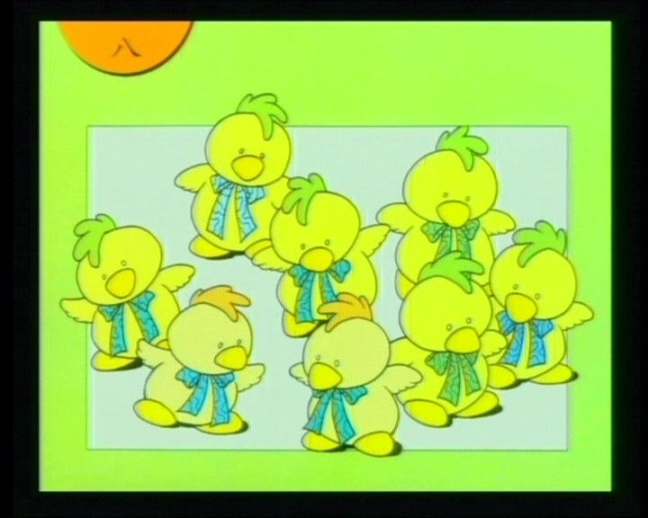
How many chickens?
eight

Slide 17
Learn a song:
Ten Little Fingers
one little ,two little, three little fingers,
four little ,five little, six little fingers,
seven little ,eight little, nine little fingers,
ten fingers on my hands.

Slide 18
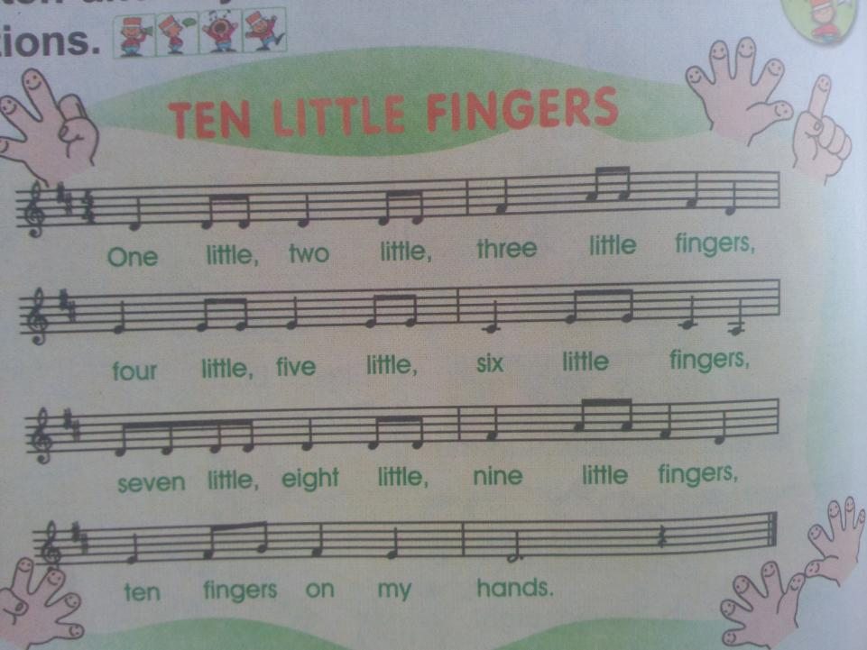

Slide 19
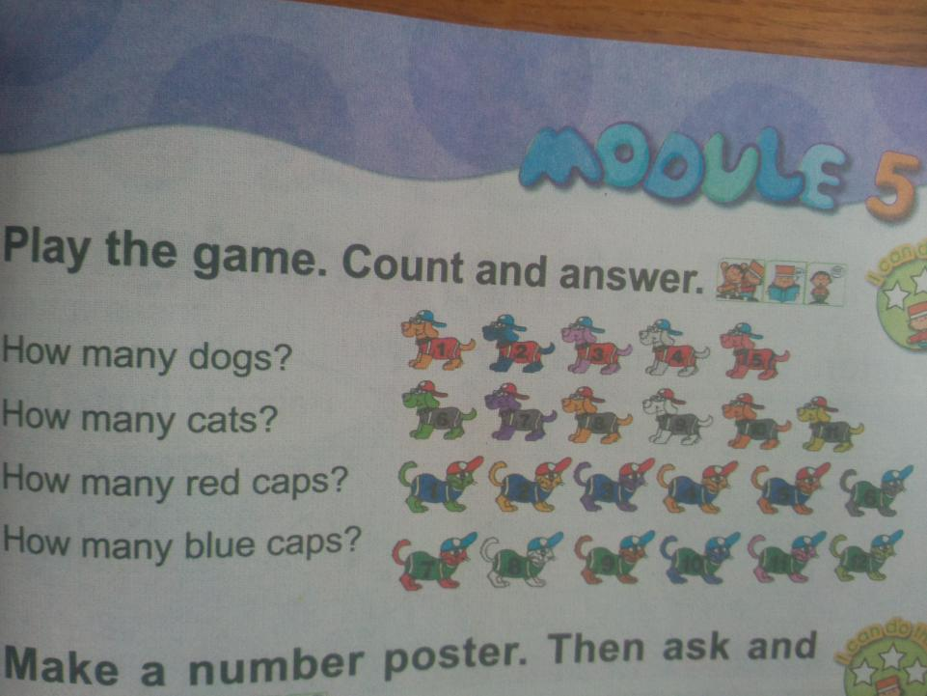

Slide 20
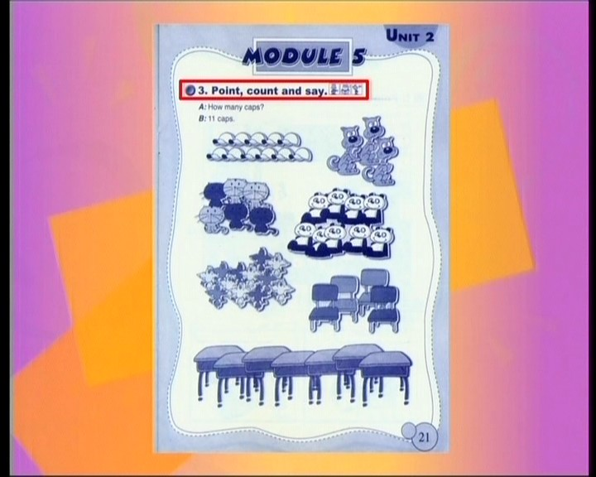
Work in groups:count and answer.
eleven
three
six
nine
twelve
four
seven

Slide 21
Homework：
1、Remember the numbers from one to twelve. 记住有关数字1-12的单词。
2、回家问问父母的电话号码，试着用英语读一读。

